Slide 1


ABNJ Tuna Project
December 2015
T-RFMO Shark
Data Inventory Browser
About
How to Use
References
Browse
ESC to Quit

Slide 2

About >
This browser was created for the ABNJ Tuna Project in December 2015
All data were extracted from public domain sources
This is a low-cost prototype designed to test proof of concept; future versions may be web-based
Please contact shelley.clarke@wcpfc.int about any errors, questions or suggestions for improvements
Back

Slide 3



How to Use >
On each screen, click on any rectangular button to choose the next view
Move to previous view using “Back” or to the start using “Top” buttons
On each screen hovering over icons will show interpretative text; hovering over will briefly introduce the data source
Some views have hyperlinks to websites (click , and depending on browser then click ALT+TAB to view)
Full data sources are accessible by clicking the “References” button on the top page
Press ESC at any time to quit
Back

Slide 4
References >
CCSBT
  All data from CCSBT-ERS/1503/06 “Summaries from the 2014 ERSWG Data Exchange”
IATTC
  Data downloaded from http://www.iattc.org/CatchReportsDataENG.htm
  IATTC (various years). Fishery Status Reports. – Tuna, Billfishes and Other Pelagic Species in the Eastern Pacific Ocean in 20XX. http://www.iattc.org/FisheryStatusReportsENG.htm
  IATTC (various years). AIDCP (MOP) Reports. http://www.iattc.org/AIDCP-Reports-IDCPENG.htm
  Murua, H., M. N. Santos, P. Chavance, J. Amande, F. J. Abascal, J. Ariz, P. Bach, M. Korta, F. Poisson, R. Coelho, and B. Seret. 2013. EU project for the Provision of Scientific Advice for the Purpose of the implementation of the EUPOA sharks. Available online at ec.europa.eu/fisheries/.../studies/sharks/scientific-advice-sharks_en.pdf
  Ecosystem Considerations. 2015. IATTC Scientific Advisory Committee Report 06/09.
ICCAT
  Data downloaded from https://www.iccat.int/en/accesingdb.htm
  ICCAT Biennial Reports 2012-13, Parts I & II. https://www.iccat.int/en/pubs_biennial.htm
  SCRS Executive Summary Sharks. https://www.iccat.int/Documents/SCRS/ExecSum/SHK_EN.pdf
IOTC
  Data downloaded from http://www.iotc.org/data/datasets
  Ecological Risk Assessment. 2012. IOTC Paper 2012-SC15-INF10.
  Update on the Implementation of the IOTC Regional Observer Scheme (IOTC–2015–WPEB11–08)
  Review of the Statistical Data Available for Bycatch Species (IOTC–2015–WPEB11–07)
  Report of the 11th Session of the IOTC Working Party on Ecosystems and Bycatch, Olhão, Portugal 7–11 September 2015 (IOTC–2015–WPEB11–R[E])
WCPFC
  SPC (Pacific Community). Catch Effort Query System. http://www.spc.int/oceanfish/en/ofpsection/data-management/spc-members/dd/247-ces
  SPC (Pacific Community). L-Best Public Domain Logsheet Data (provided on request)
  SPC (Pacific Community). Status of ROP Data Management with tables on ROP longline coverage (WCPFC-TCC11-2015-IP05_rev2)
  WCPFC Scientific Committee 2, Summary Report, 2006. https://www.wcpfc.int/meetings/2nd-regular-session
Back

Slide 5
Start >
Browse by:
by t-RFMO
by Shark
Species /Group
by Gear / Fishery
Global Figures for all Sharks
Back

Slide 6
Choose t-RFMO Area >
ICCAT
WCPFC
IOTC
IATTC
CCSBT
CCSBT
CCSBT
Back
Top

Slide 7
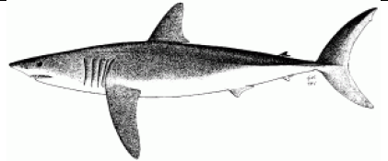
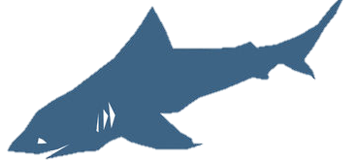
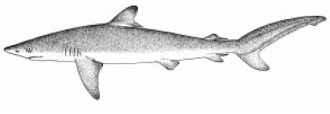
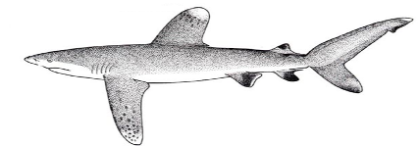
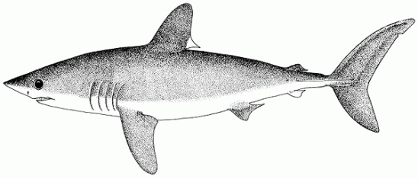
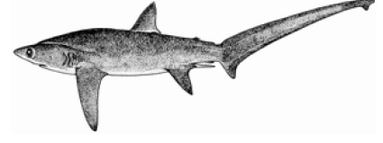
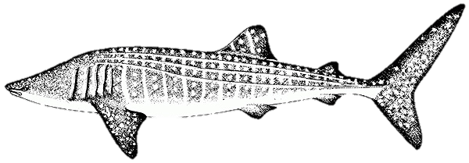
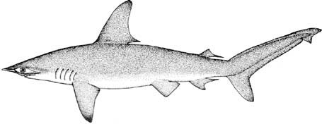
Choose Species/Group >
Blue (Prionace glauca)
Makos (Isurus spp.)
Other sharks
Silky (Carcharhinus falciformis)
Oceanic whitetip (Carcharhinus longimanus)
Threshers (Alopias spp.)
Porbeagle (Lamna nasus)
Hammerheads (Sphyrna spp.)
Whale (Rhincodon typus)
Back
Top

Slide 8
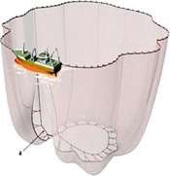
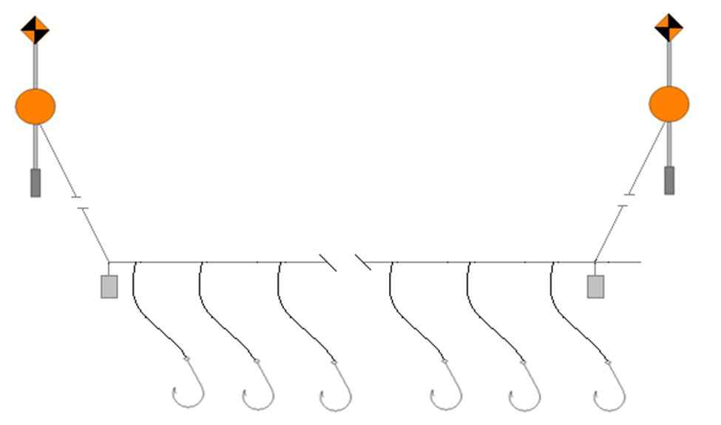
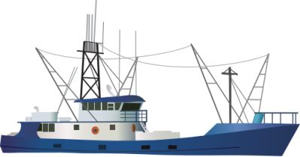
Choose Gear/Fishery >
Longline Fishery
Purse Seine Fishery
Back
Top

Slide 9
Blue Shark >
Catch by t-RFMO
Ecological Risk
Catch by Gear Type
Stock Assessment
Catch by Flag State
Management Measures
Back
Top

Slide 10
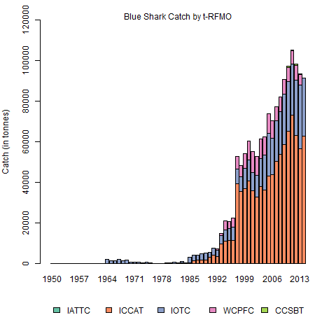
Blue Shark > Catch by t-RFMO
Back
Top
Notes:
File: Species Specific Plots.r
Plot: SppSpOceanBSH

Slide 11
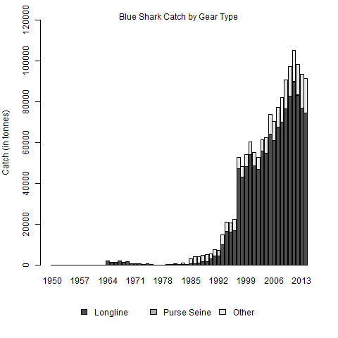
Blue Shark > Catch by Gear
Back
Top
Notes:
File: Species Specific Plots.r
Plot: SppSpGearBSH

Slide 12
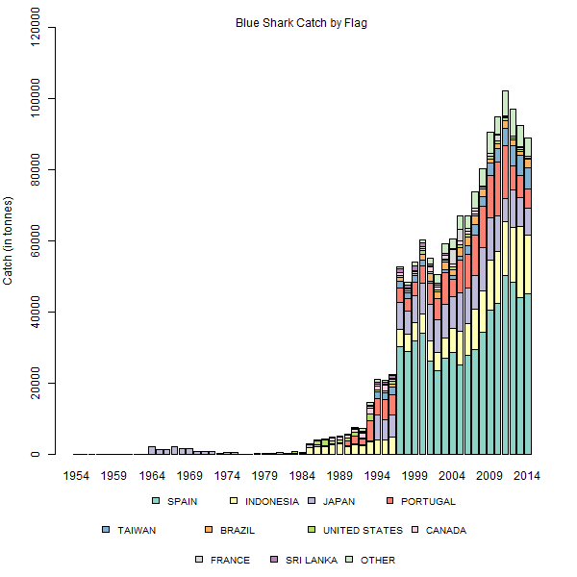
Blue Shark > Catch by Flag
Back
Top
Notes:
File: Species Specific Plots.r
Plot: SppSpFlagBSH

Slide 13
Blue Shark > Ecological Risk
Species | Ocean | Fishery | Risk Ranking (n^{th} most vulnerable) | See full regional ranking?
Blue | Eastern Pacific | Purse Seine | not ranked
Blue | North Atlantic | Longline | 11th of 20
Blue | South Atlantic | Longline | 14th of 20
Blue | Indian | Purse Seine | 17th of 17
Blue | Indian | Longline | 10th of 16
Blue | Western Central Pacific | Longline | 20th of 22
Back
Top
Notes:
File: Species Specific Plots.r
Plot: SppSpFlagBSH

Slide 14

Blue Shark > Stock Assessments
Ocean | Atlantic |  | Western Central Pacific |  | Indian
Stock | North | South | North | South
Year Last Assessed | 2015 | 2015 | 2014 | 2016 (in progress) | 2015
Overfished? | NO | BSP: NO; state space BSP: YES | Likely no |  | No (all three models)
Overfishing? | NO | BSP: NO; state space BSP: YES | Likely no |  | Yes (SS3 and SRA models); No (BSSPM model)
Notes | assessment results are uncertain and should be interpreted with caution | assessment results are uncertain and should be interpreted with caution | substantial uncertainty in the model results require caution when interpreting the results |  | “a best case model could not be selected and so the results represented the range of plausible model runs"
Links
Back
Top
Notes:
File: Species Specific Plots.r
Plot: SppSpFlagBSH

Slide 15

Blue Shark> Management Measures
t-RFMO | Measure | Year | Species | Key Concepts | Link
No t-RFMO management measures specific to blue shark. For measures that apply to all sharks, click here:
Back
Top
Notes:
Script: Shark Catch Composites.R
Plot: Browser_Egearplot.png

Slide 16
Mako Shark >
Catch by t-RFMO
Ecological Risk
Catch by Gear Type
Stock Assessment
Catch by Flag State
Management Measures
Back
Top

Slide 17
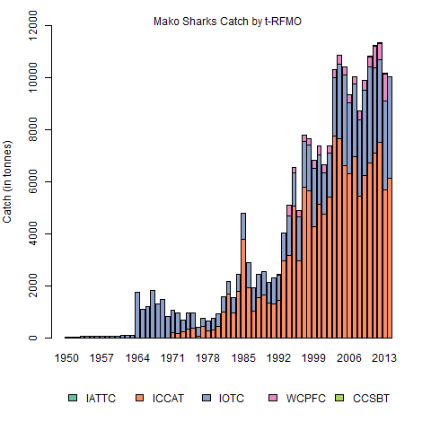
Mako Sharks > Catch by t-RFMO
Back
Top
Notes:
File: Species Specific Plots.r
Plot: SppSpOceanMAK

Slide 18
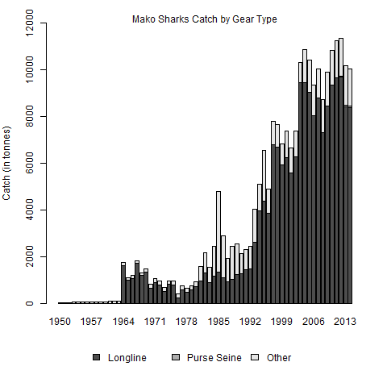
Mako Sharks > Catch by Gear
Back
Top
Notes:
File: Species Specific Plots.r
Plot: SppSpGearMAK

Slide 19
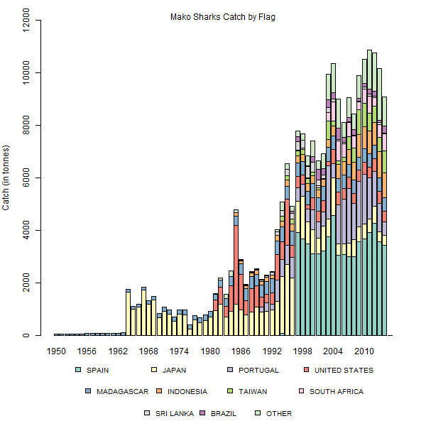
Mako Sharks > Catch by Flag
Back
Top
Notes:
File: Species Specific Plots.r
Plot: SppSpFlagMAK

Slide 20
Mako Sharks > Ecological Risk
Species | Ocean | Fishery | Risk Ranking (n^{th} most vulnerable) | See full regional ranking?
Shortfin mako | Eastern Pacific | Purse Seine | 3rd of 9
Longfin mako | Atlantic | Longline | 2nd of 20
Shortfin mako | Atlantic | Longline | 3rd of 20
Shortfin mako | Indian | Purse Seine | 17th of 17
Longfin mako | Indian | Purse Seine | 10th of 16
Shortfin mako | Indian | Longline | 1st of 16
Longfin mako | Indian | Longline | 8th of 16
Shortfin mako | Western Central Pacific | Longline | 2nd of 22
Back
Top
Notes:
File: Species Specific Plots.r
Plot: SppSpFlagBSH

Slide 21
Mako Sharks > Stock Assessments
Ocean | Atlantic |  | Western Central Pacific
Stock | Shortfin Mako -North | Shortfin Mako -South | Shortfin Mako -North | Shortfin Mako -South
Year Last Assessed | 2012 | 2012 | 2015
Overfished? | NO | NO | Undetermined
Overfishing? | NO | NO | Undetermined
Notes | Inconsistencies and uncertainties suggest results may be unreliable | Inconsistencies and uncertainties suggest results may be unreliable | further work required
Links
Back
Top
Notes:
File: Species Specific Plots.r
Plot: SppSpFlagBSH

Slide 22
Mako Sharks> Management Measures
t-RFMO | Measure | Year | Species | Key Concepts | Link
ICCAT | 2005-05 | 2005 | shortfin mako | mortality reduction
ICCAT | 2010-06 | 2010 | shortfin mako | continued retention conditional upon data submission
ICCAT | 2014-06 | 2014 | shortfin mako | mortality reduction, data submission, research
ICCAT | 2007-06 | 2007 | shortfin mako, porbeagle | data submission, mortality reduction, nursery areas
For measures that apply to all sharks, click here:
Back
Top
Notes:
Script: Shark Catch Composites.R
Plot: Browser_Egearplot.png

Slide 23
Silky Shark >
Catch by t-RFMO
Ecological Risk
Catch by Gear Type
Stock Assessment
Catch by Flag State
Management Measures
Back
Top

Slide 24
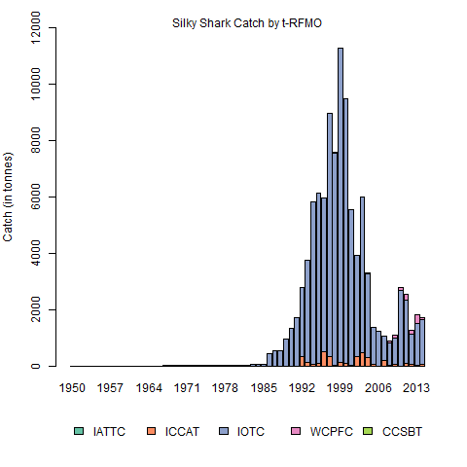
Silky Shark >Catch by t-RFMO
Back
Top

Slide 25
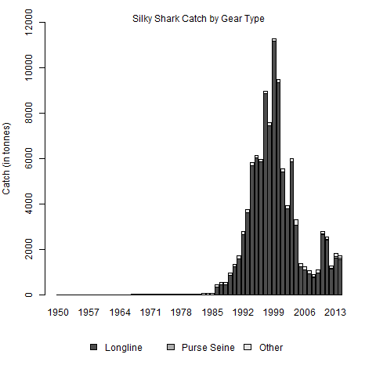
Silky Shark >Catch by Gear
Back
Top

Slide 26
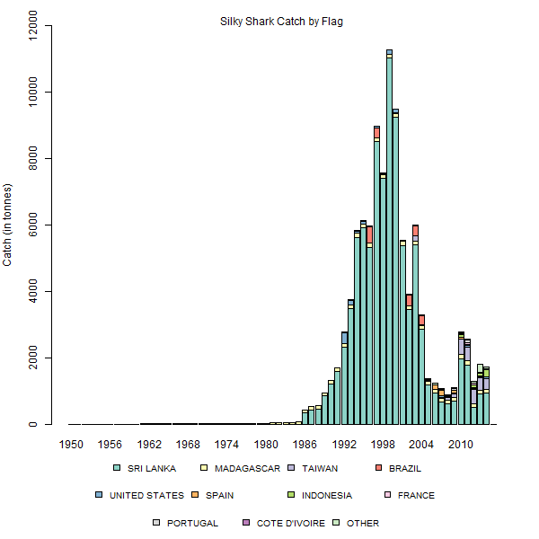
Silky Shark >Catch by Flag
Back
Top

Slide 27
Silky Shark> Ecological Risk
Species | Ocean | Fishery | Risk Ranking (n^{th} most vulnerable) | See full regional ranking?
Silky | Eastern Pacific | Purse Seine | 1st of 9
Silky | North Atlantic | Longline | 9th of 20
Silky | South Atlantic | Longline | 6th of 20
Silky | Indian | Purse Seine | 2nd of 17
Silky | Indian | Longline | 4th of 16
Silky | Western Central Pacific | Longline | 14th of 22
Back
Top
Notes:
File: Species Specific Plots.r
Plot: SppSpFlagBSH

Slide 28
Silky Shark > Stock Assessments
Ocean | Eastern Pacific | Western Central Pacific
Stock | Tropical | Tropical
Year Last Assessed | 2015 | 2013
Overfished? | Undetermined | Yes
Overfishing? | Undetermined | Yes
Notes | "conventional stock assessment models have been severely handicapped by major uncertainties in the fishery data" | F_{current}/F_{MSY} = 4.48; biomass estimated at 27% of virgin (or 70% of SB_{msy})
Links
Back
Top
Notes:
File: Species Specific Plots.r
Plot: SppSpFlagBSH

Slide 29
Silky Sharks> Management Measures
t-RFMO | Measure | Year | Species | Key Concepts | Link
ICCAT | 2011-08 | 2011 | silky | prohibits retention (with exceptions); live release; data submission
WCPFC | 2013-08 | 2013 | silky | prohibition on retention; prompt release unharmed; data submission; research
For measures that apply to all sharks, click here:
Back
Top
Notes:
Script: Shark Catch Composites.R
Plot: Browser_Egearplot.png

Slide 30
Oceanic Whitetip Shark >
Catch by t-RFMO
Ecological Risk
Catch by Gear Type
Stock Assessment
Catch by Flag State
Management Measures
Back
Top

Slide 31
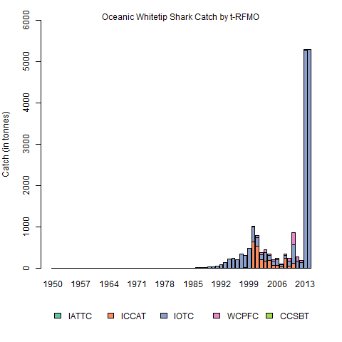
Oceanic Whitetip Shark >Catch by t-RFMO
Back
Top
Notes:
File: Species Specific Plots.r
Plot: SppSpOceanFAL

Slide 32
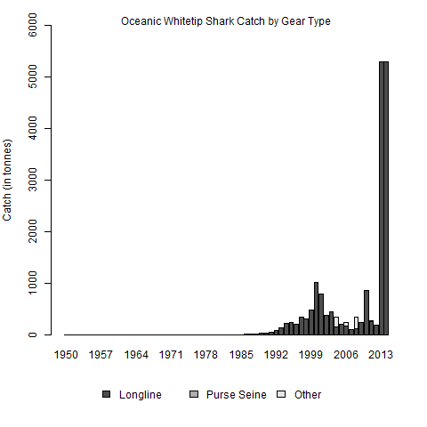
Oceanic Whitetip Shark >Catch by Gear
Back
Top
Notes:
File: Species Specific Plots.r
Plot: SppSpGearFAL

Slide 33
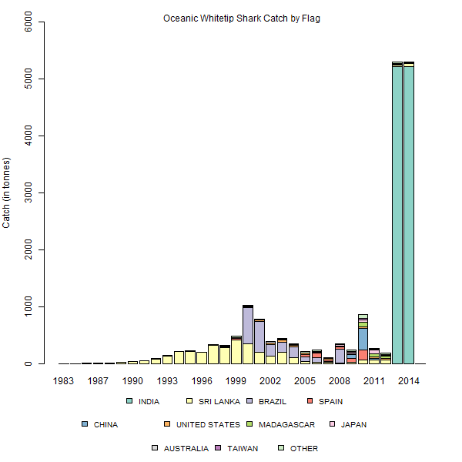
Oceanic Whitetip Shark >Catch by Flag
Back
Top
Notes:
File: Species Specific Plots.r
Plot: SppSpFlagFAL

Slide 34
Oceanic Whitetip Shark> Ecological Risk
Species | Ocean | Fishery | Risk Ranking (n^{th} most vulnerable) | See full regional ranking?
Oceanic Whitetip | Eastern Pacific | Purse Seine | 6th of 9
Oceanic Whitetip | Atlantic | Longline | 8th of 20
Oceanic Whitetip | Indian | Purse Seine | 1st of 17
Oceanic Whitetip | Indian | Longline | 5th of 16
Oceanic Whitetip | Western Central Pacific | Longline | 22nd of 22
Back
Top
Notes:
File: Species Specific Plots.r
Plot: SppSpFlagBSH

Slide 35
Oceanic Whitetip > Stock Assessments
Ocean | Western Central Pacific
Stock | Tropical
Year Last Assessed | 2012
Overfished? | Yes
Overfishing? | Yes
Notes | F_{current}/F_{MSY} = 6.5; biomass estimated at 7% of virgin (or 15% of SB_{msy})
Links
Back
Top
Notes:
File: Species Specific Plots.r
Plot: SppSpFlagBSH

Slide 36
Oceanic Whitetip Sharks> Management Measures
t-RFMO | Measure | Year | Species | Key Concepts | Link
IATTC | C-11-10 | 2011 | oceanic whitetip | prohibits retention; encourages prompt release; reporting of discards
ICCAT | 2010-07 | 2010 | oceanic whitetip | prohibits retention, data submission
IOTC | 2013-06 | 2013 | oceanic whitetip | prohibition on retention; prompt release unharmed; data submission; research
WCPFC | 2011-04 | 2011 | oceanic whitetip | prohibition on retention; prompt release unharmed; data submission; research
For measures that apply to all sharks, click here:
Back
Top
Notes:
Script: Shark Catch Composites.R
Plot: Browser_Egearplot.png

Slide 37
Thresher Sharks >
Catch by t-RFMO
Ecological Risk
Catch by Gear Type
Stock Assessment
Catch by Flag State
Management Measures
Back
Top

Slide 38
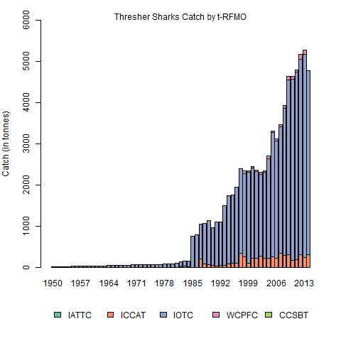
Thresher Sharks >Catch by t-RFMO
Back
Top
Notes:
File: Species Specific Plots.r
Plot: SppSpOceanTHR

Slide 39
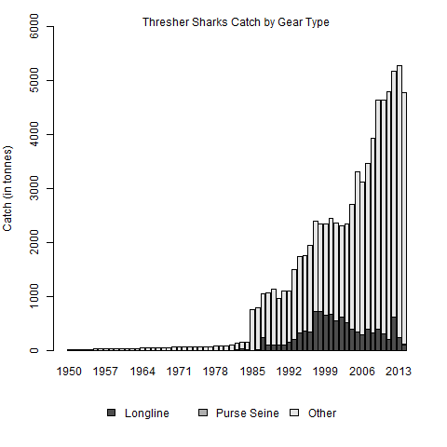
Thresher Sharks >Catch by Gear
Back
Top
Notes:
File: Species Specific Plots.r
Plot: SppSpGearTHR

Slide 40
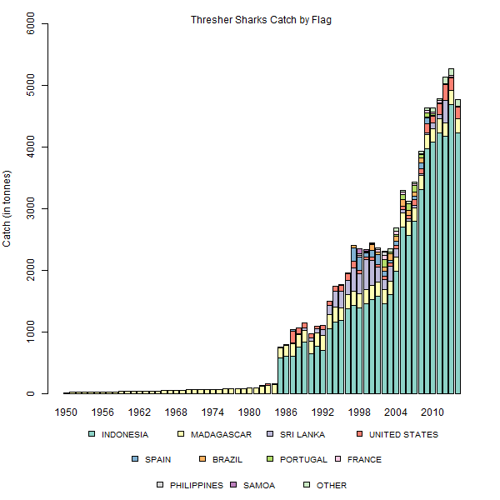
Thresher Sharks >Catch by Flag
Back
Top
Notes:
File: Species Specific Plots.r
Plot: SppSpFlagTHR

Slide 41
Thresher Sharks > Ecological Risk
Species | Ocean | Fishery | Risk Ranking (n^{th} most vulnerable) | See full regional ranking?
Bigeye Thresher | Eastern Pacific | Purse Seine | 2nd of 9
Common Thresher | Eastern Pacific | Purse Seine | 9th of 9
Pelagic Thresher | Eastern Pacific | Purse Seine | 5th of 9
Bigeye Thresher | Atlantic | Longline | 1st of 20
Common Thresher | Atlantic | Longline | 10th of 20
Bigeye Thresher | Indian | Purse Seine | 12th of 17
Common Thresher | Indian | Purse Seine | 11th of 17
Pelagic Thresher | Indian | Purse Seine | 15th of 17
Bigeye Thresher | Indian | Longline | 2nd of 16
Common Thresher | Indian | Longline | 16th of 16
Pelagic Thresher | Indian | Longline | 3rd of 16
Bigeye Thresher | Western Central Pacific | Longline | 10th of 22
Common Thresher | Western Central Pacific | Longline | 21st of 22
Pelagic Thresher | Western Central Pacific | Longline | 19th of 22
Back
Top
Notes:
File: Species Specific Plots.r
Plot: SppSpFlagBSH

Slide 42
Threshers > Stock Assessments
Ocean | Pacific (entire)
Stock | Bigeye Thresher (Tropical)
Year Last Assessed | 2016 (in progress)
Overfished?
Overfishing?
Notes
Links
Back
Top
Notes:
File: Species Specific Plots.r
Plot: SppSpFlagBSH

Slide 43
Thresher Sharks> Management Measures
t-RFMO | Measure | Year | Species | Key Concepts | Link
ICCAT | 2009-07 | 2009 | bigeye thresher | prohibits retention (with exceptions); live release; data submission, nursery areas
IOTC | 2012-09 | 2012 | threshers | prohibition on retention; prompt release unharmed; data submission; research
For measures that apply to all sharks, click here:
Back
Top
Notes:
Script: Shark Catch Composites.R
Plot: Browser_Egearplot.png

Slide 44
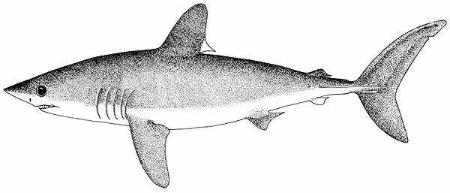
Porbeagle Shark >
Catch by t-RFMO
Ecological Risk
Catch by Gear Type
Stock Assessment
Catch by Flag State
Management Measures
Back
Top

Slide 45
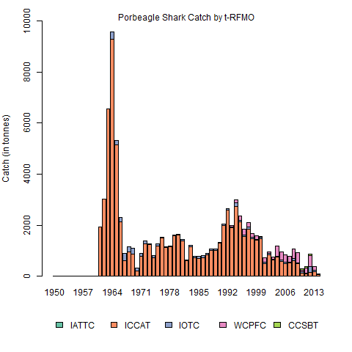
Porbeagle Shark >Catch by t-RFMO
Back
Top
Notes:
File: Species Specific Plots.r
Plot: SppSpOceanPOR

Slide 46
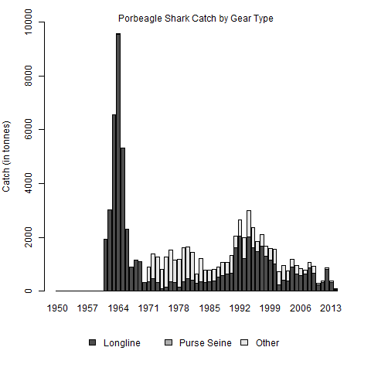
Porbeagle Shark >Catch by Gear
Back
Top
Notes:
File: Species Specific Plots.r
Plot: SppSpGearPOR

Slide 47
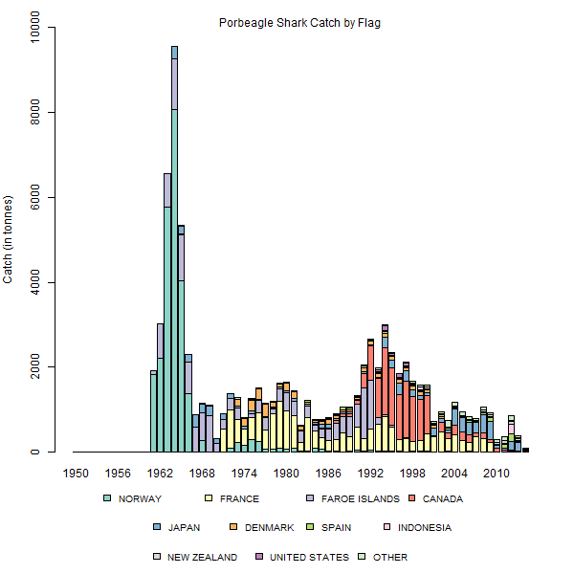
Porbeagle Shark >Catch by Flag
Back
Top
Notes:
File: Species Specific Plots.r
Plot: SppSpFlagPOR

Slide 48
Porbeagle Shark> Ecological Risk
Species | Ocean | Fishery | Risk Ranking (n^{th} most vulnerable) | See full regional ranking?
Porbeagle | Atlantic | Longline | 4th of 20
Porbeagle | Indian | Purse Seine | 14th of 17
Porbeagle | Indian | Longline | 7th of 16
Porbeagle | Western Central Pacific | Longline | 8th of 22
Back
Top
Notes:
File: Species Specific Plots.r
Plot: SppSpFlagBSH

Slide 49
Porbeagle > Stock Assessments
Ocean | Atlantic |  |  |  | Southern
Stock | Northwest | Northeast | Southwest | Southeast | Southern Hemisphere
Year Last Assessed | 2009 | 2009 | 2009 | 2009 | 2016 (in progress)
Overfished? | YES | YES | INCONCLUSIVE | INCONCLUSIVE
Overfishing? | NO | LIKELY YES OR YES | INCONCLUSIVE | INCONCLUSIVE
Notes | fishery closed in 2013; recovery will require >=20 years | TAC set to zero since 2010; with no take recovery will take 15-34 years | Uruguay prohibited retention in 2013
Links
Back
Top
Notes:
File: Species Specific Plots.r
Plot: SppSpFlagBSH

Slide 50

Porbeagle Sharks> Management Measures
t-RFMO | Measure | Year | Species | Key Concepts | Link
ICCAT | 2007-06 | 2007 | shortfin mako, porbeagle | data submission, mortality reduction, nursery areas
ICCAT | 2015-06 | 2015 | porbeagle | live release, data submission, research
For measures that apply to all sharks, click here:
Back
Top
Notes:
Script: Shark Catch Composites.R
Plot: Browser_Egearplot.png

Slide 51
Hammerhead Sharks >
Catch by t-RFMO
Ecological Risk
Catch by Gear Type
Stock Assessment
Catch by Flag State
Management Measures
Back
Top

Slide 52
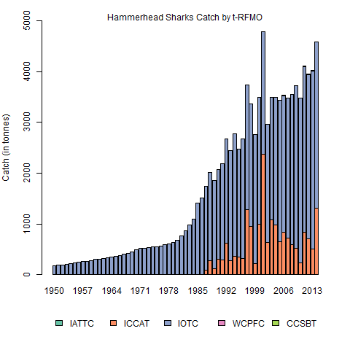
Hammerhead Sharks >Catch by t-RFMO
Back
Top
Notes:
File: Species Specific Plots.r
Plot: SppSpOceanSPY

Slide 53
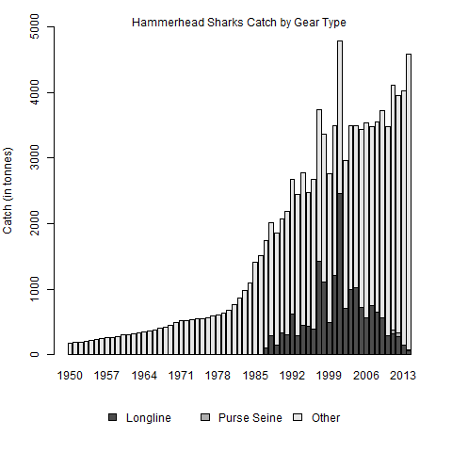
Hammerhead Sharks >Catch by Gear
Back
Top
Notes:
File: Species Specific Plots.r
Plot: SppSpGearSPY

Slide 54
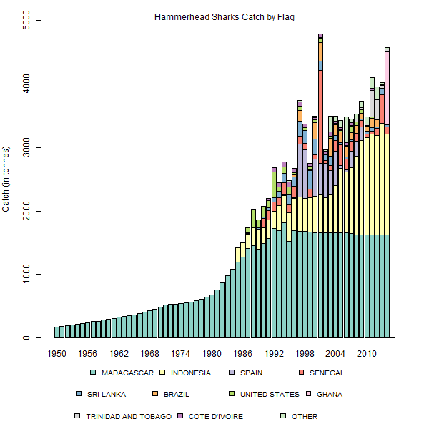
Hammerhead Sharks >Catch by Flag
Back
Top
Notes:
File: Species Specific Plots.r
Plot: SppSpFlagSPY

Slide 55
Hammerhead Sharks > Ecological Risk
Species | Ocean | Fishery | Risk Ranking (n^{th} most vulnerable) | See full regional ranking?
Great Hammerhead | Eastern Pacific | Purse Seine | 4th of 9
Scalloped Hammerhead | Eastern Pacific | Purse Seine | 7th of 9
Smooth Hammerhead | Eastern Pacific | Purse Seine | 8th of 9
Great Hammerhead | Atlantic | Longline | 13th of 20
Scalloped Hammerhead | North Atlantic | Longline | 17th of 20
Scalloped Hammerhead | South Atlantic | Longline | 19th of 20
Smooth Hammerhead | Atlantic | Longline | 18th of 20
Scalloped Hammerhead | Indian | Purse Seine | 6th of 17
Smooth Hammerhead | Indian | Purse Seine | 7th of 17
Smooth Hammerhead | Indian | Longline | 6th of 16
Great Hammerhead | Indian | Longline | 9th of 16
Scalloped Hammerhead | Indian | Longline | 14th of 16
Scalloped Hammerhead | Western Central Pacific | Longline | 11th of 22
Back
Top
Notes:
File: Species Specific Plots.r
Plot: SppSpFlagBSH

Slide 56
Hammerhead Sharks> Management Measures
t-RFMO | Measure | Year | Species | Key Concepts | Link
ICCAT | 2010-08 | 2010 | hammerheads | prohibits retention (with exceptions); live release; data submission, nursery areas
For measures that apply to all sharks, click here:
Back
Top
Notes:
Script: Shark Catch Composites.R
Plot: Browser_Egearplot.png

Slide 57
Whale Shark >
Catch by t-RFMO
Ecological Risk
Catch by Gear Type
Stock Assessment
Catch by Flag State
Management Measures
Back
Top

Slide 58
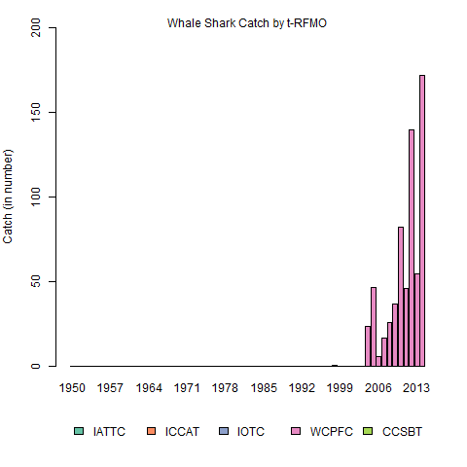
Whale Sharks >Catch by t-RFMO
Back
Top
Notes:
File: Species Specific Plots.r
Plot: SppSpOceanRHN

Slide 59
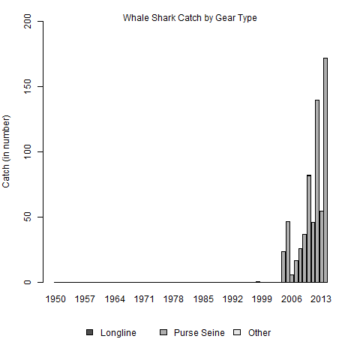

Whale Sharks >Catch by Gear
Back
Top
Notes:
File: Species Specific Plots.r
Plot: SppSpGearRHN

Slide 60
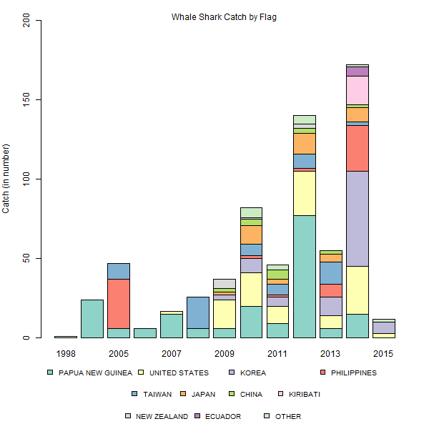
Whale Sharks >Catch by Flag
Back
Top
Notes:
File: Species Specific Plots.r
Plot: SppSpFlagRHN

Slide 61
Whale Shark> Ecological Risk
Species | Ocean | Fishery | Risk Ranking (n^{th} most vulnerable) | See full regional ranking?
 | Eastern Pacific | Purse Seine | na
 | Atlantic | Longline | na
 | Indian | Purse Seine | na
 | Indian | Longline | na
 | Western Central Pacific | Longline | 1st of 22
Back
Top
Notes:
File: Species Specific Plots.r
Plot: SppSpFlagBSH

Slide 62
Whale Sharks> Management Measures
t-RFMO | Measure | Year | Species | Key Concepts | Link
IOTC | 2013-05 | 2013 | whale | prohibition on intentional setting; safe release; reporting of interactions
WCPFC | 2012-04 | 2013 | whale | prohibition on intentional setting; safe release; reporting of interactions
ADD IATTC C-15-03
https://www.iattc.org/PDFFiles2/Resolutions/C-15-03-Amendment-C-13-04-FADs.pdf
For measures that apply to all sharks, click here:
Back
Top
Notes:
Script: Shark Catch Composites.R
Plot: Browser_Egearplot.png

Slide 63
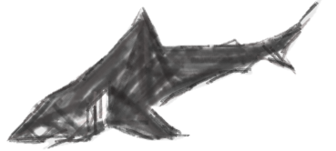
Other Sharks Menu>
Other sharks identified to species
Other sharks recorded only as “shark”
Back
Top
Notes:
File: Species Specific Plots.r
Plot: SppSpGearRHN

Slide 64
Other Sharks (Identified)>
Catch by t-RFMO
Ecological Risk
Catch by Gear Type
Stock Assessment
Catch by Flag State
Management Measures
Back
Top
Notes:
File: Species Specific Plots.r
Plot: SppSpGearRHN

Slide 65
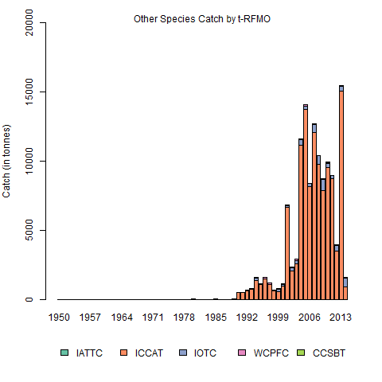
Other Sharks >Catch by t-RFMO
Back
Top
Notes:
File: Species Specific Plots.r
Plot: SppSpOceanOTH

Slide 66
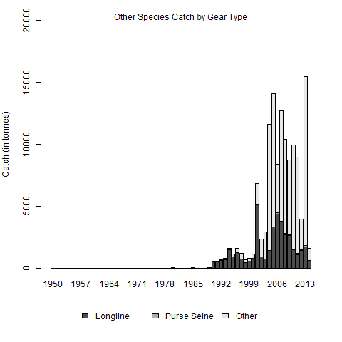
Other Sharks >Catch by Gear
Back
Top
Notes:
File: Species Specific Plots.r
Plot: SppSpGearOTH

Slide 67
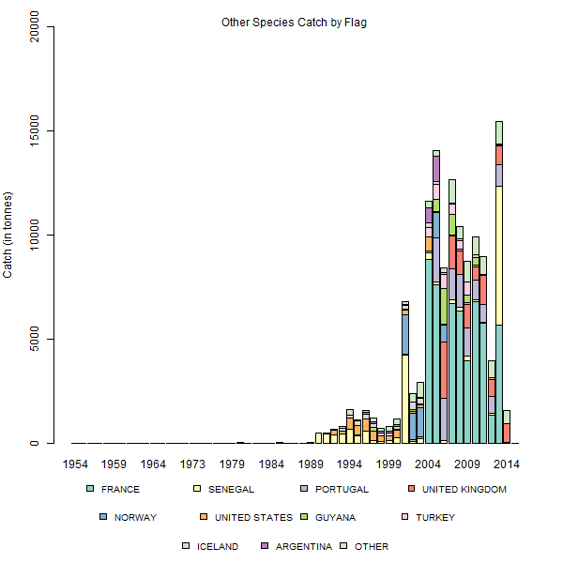
Other Sharks >Catch by Flag
Back
Top
Notes:
File: Species Specific Plots.r
Plot: SppSpFlagOTH

Slide 68
Other Sharks> Management Measures
t-RFMO | Measure | Year | Species | Key Concepts | Link
IATTC | C-15-04 | 2015 | Mobulid rays | prohibits retention (with exceptions); live release; data submission
For measures that apply to all sharks, click here:
Back
Top
Notes:
Script: Shark Catch Composites.R
Plot: Browser_Egearplot.png

Slide 69
Shark (unidentified)>
Catch by t-RFMO
Ecological Risk
Catch by Gear Type
Stock Assessment
Catch by Flag State
Management Measures
Back
Top

Slide 70
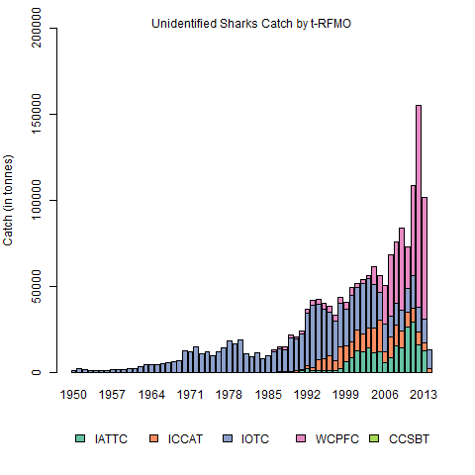
Shark UID>Catch by t-RFMO
Back
Top
Notes:
File: Species Specific Plots.r
Plot: SppSpOceanSHK

Slide 71
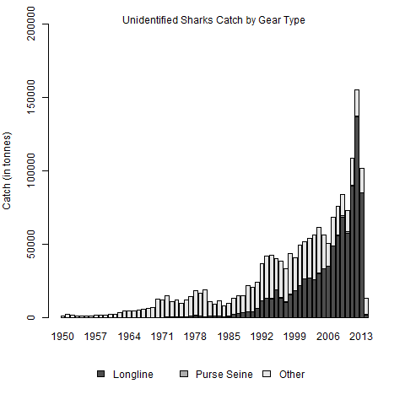
Shark UID>Catch by Gear
Back
Top
Notes:
File: Species Specific Plots.r
Plot: SppSpGearSHK

Slide 72
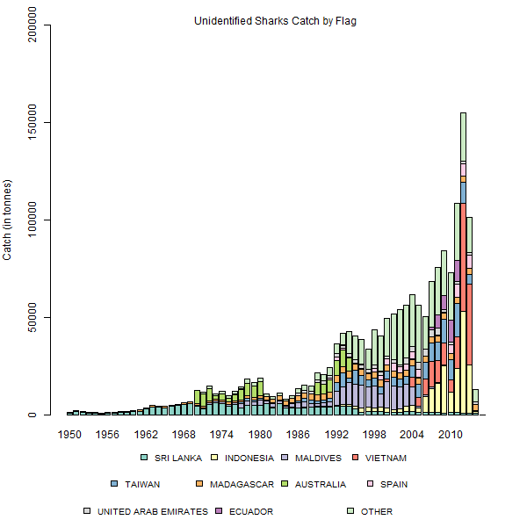
Shark UID>Catch by Flag
Back
Top
Notes:
File: Species Specific Plots.r
Plot: SppSpFlagSHK

Slide 73
Shark UID > Management Measures
t-RFMO | Measure | Year | Species | Key Concepts | Link
IATTC | C-05-03 | 2005 | all sharks | full utilization; 5% fins:carcass ratio; live release; research; data provision
ICCAT | 2004-10 | 2004 | all sharks | full utilization; 5% fins:carcass ratio; live release; research; data provision
ICCAT | 2012-05 | 2012 | all sharks | provision of implementation of, and compliance with, existing shark management measures
IOTC | 2005-05 | 2005 | all sharks | full utilization; 5% fins:carcass ratio; live release; research; data provision
WCPFC | 2010-07 | 2010 | all sharks | full utilization; 5% fins:carcass ratio; live release; research; data provision
WCPFC | 2014-08 | 2014 | all sharks | prohibition of either wire leaders or sharklines (fleet choice); requirement for management plans for fisheries targetting sharks
Back to Species
Back to Shark UID
Top
Notes:
Script: Shark Catch Composites.R
Plot: Browser_Egearplot.png

Slide 74
CCSBT (Southern Ocean) > menu
Fishing Effort and Trend
Observer Coverage Achieved
Shark Catch by Species
Shark Ecological Risk Assessment
Shark Catch by Flag State
Shark Stock Assessment
Shark Catch by Gear Type
Shark Management Measures
Back
Top

Slide 75
CCSBT (Southern Ocean) > Fishing Effort
For this region, fishing effort data are available for the:
Longline Fishery
Purse Seine Fishery
Back
Top
Notes:
Script: Shark Catch Composites.R
Plot: Browser_Egearplot.png

Slide 76
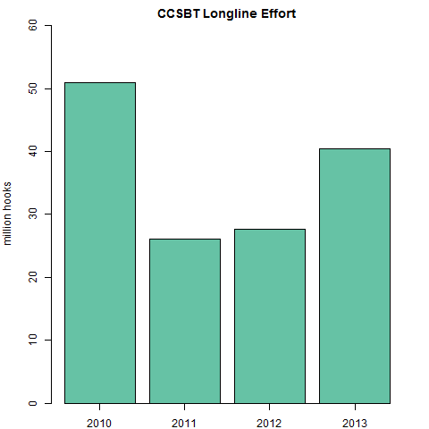
CCSBT (Southern Ocean ) > Fishing Effort and Trend
Back
Top
Notes:
Script: Simple Bar Charts for LL Hooks.R
Plot: Browser_S1plot.png

Slide 77
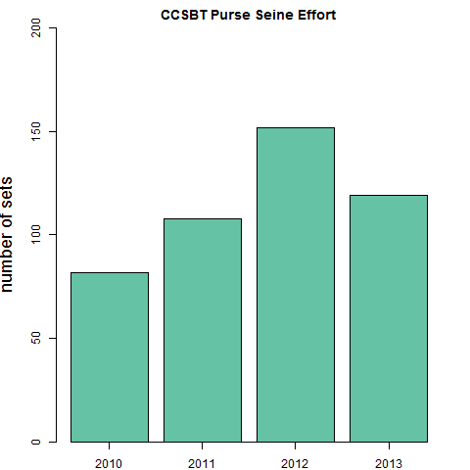
CCSBT (Southern Ocean ) > Fishing Effort and Trend
Back
Top
Notes:
Script: Simple Bar Charts for PS Effort.R
Plot: Browser_S2plot.png

Slide 78
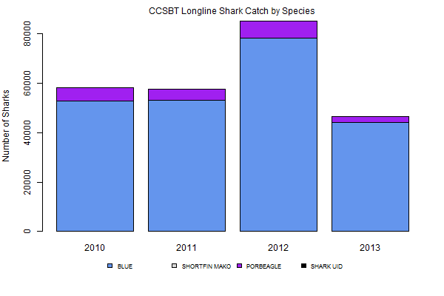
CCSBT (Southern Ocean ) > Shark Catch by Species
Back
Top
Notes:
Script: CCSBT Make Barcharts from Year, Flag, Species, Catch.R
Plot: Browser_S5aplot.png

Slide 79
CCSBT (Southern Ocean ) > Observer Coverage
Observer coverage was reported by flag States and tallied by CCSBT for the Southern Ocean longline and purse seine fisheries in 2010-2013 as follows:
 | Longline | Purse Seine
 | (hooks observed) | (sets observed)
2010 | 8.6% | 25.6%
2011 | 9.7% | 15.7%
2012 | 14.0% | 11.2%
2013 | 11.7% | 11.8%
Back
Top
Notes:
Script: Simple Bar Charts for PS Effort.R
Plot: Browser_S2plot.png

Slide 80
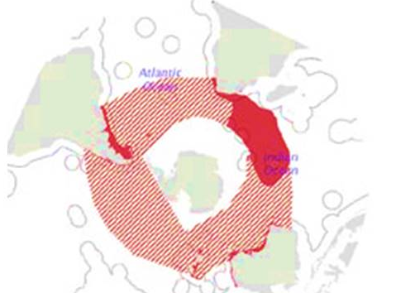
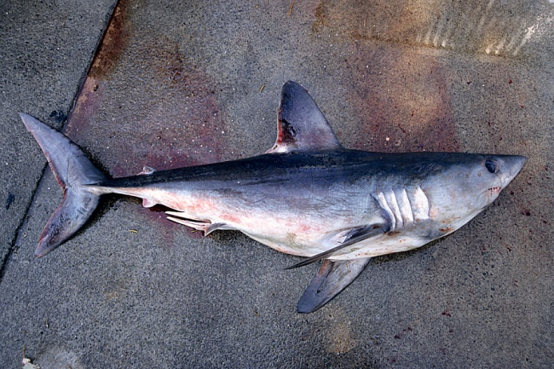



CCSBT (Southern Ocean ) > Stock Assessment
A southern hemisphere porbeagle (Lamna nasus) stock status assessment is currently underway and is scheduled for completion by the end of 2016.
Atlantic
Indian
Pacific
Photo: Malcolm Francis
Back
Top
Notes:
Script: Simple Bar Charts for PS Effort.R
Plot: Browser_S2plot.png

Slide 81
IATTC (Eastern Pacific) > menu
Fishing Effort and Trend
Observer Coverage Achieved
Shark Catch by Species
Shark Ecological Risk Assessment
Shark Catch by Flag State
Shark Stock Assessment
Shark Catch by Gear Type
Shark Management Measures
Back
Top

Slide 82
IATTC (Eastern Pacific) > Fishing Effort
For this region, fishing effort data are available for the:
Longline Fishery
Purse Seine Fishery
Back
Top
Top

Slide 83
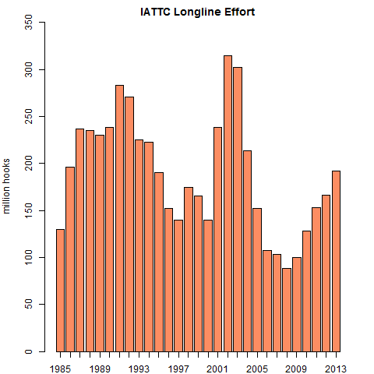
IATTC (Eastern Pacific) > Fishing Effort and Trend
Back
Top
Notes:
Script: Simple Bar Charts for LL Hooks.R
Plot: Browser_E1plot.png

Slide 84
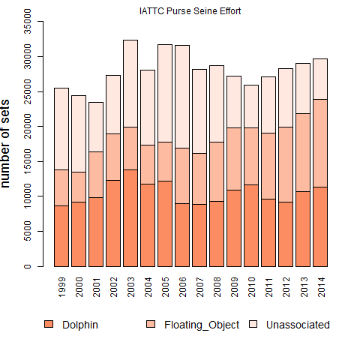
IATTC (Eastern Pacific) > Fishing Effort and Trend
Back
Top
Notes:
Script: Simple Bar Charts for PS Effort.R
Plot: Browser_E2plot.png

Slide 85

IATTC (Eastern Pacific) > Shark Catch by Species
Back
Top
Notes:
Script: Catch by Species from Observer Data.R
Plot: Browser_E5bplot.png

Slide 86

IATTC (Eastern Pacific) > Shark Catch by Flag
Longline only
Purse seine only
Back
Top
Notes:
Script: Shark Catch Composites.R
Plot: Browser_E6zplot.png

Slide 87

IATTC (Eastern Pacific) > Shark Catch by Flag (LL)
Back
Top
Notes:
Script: IATTC Make Barcharts from Year, Flag, Species, Catch.R
Plot: Browser_E6aplot.png

Slide 88

IATTC (Eastern Pacific) > Shark Catch by Flag (PS)
Back
Top
Notes:
Script: IATTC Make Barcharts from Year, Flag, Species, Catch.R
Plot: Browser_E6bplot.png

Slide 89

IATTC (Eastern Pacific) > Shark Catch by Gear Type
Back
Top
Notes:
Script: Shark Catch Composites.R
Plot: Browser_Egearplot.png

Slide 90
IATTC (Eastern Pacific) > Observer Coverage
Fishery | Coverage
Longline | In the Eastern Pacific observer coverage of 5% for longline vessels longer than 20 m, and recording of seabird, sea turtle and shark interactions by national observer programmes, was required as of January 2013 (IATTC Resolution C11-08). Current levels of implementation are unknown.
Purse Seine | Observer coverage in the Eastern Pacific purse seine fishery has been >98% in each year since 1994.
Back
Top
Notes:
Script: Simple Bar Charts for PS Effort.R
Plot: Browser_E2plot.png

Slide 91
IATTC (Eastern Pacific) > Species Risk Ranking
Back to Species
* based on the v₃ metric in which susceptibility values are adjusted for long-term trends
Back to IATTC
Top
Notes:
Script: Shark Catch Composites.R
Plot: Browser_Egearplot.png

Slide 92
IATTC (Eastern Pacific) > Shark Stock Assessments
Species | silky shark
Stock | E. Pacific (tropical)
Year Last Assessed | 2015
Overfished? | Undetermined
Overfishing? | Undetermined
Notes | "conventional stock assessment models have been severely handicapped by major uncertainties in the fishery data"
Link
Back
Top
Notes:
Script: Shark Catch Composites.R
Plot: Browser_Egearplot.png

Slide 93
IATTC (Eastern Pacific) > Shark Management Measures
Measure | Year | Species | Key Concepts | Link
C-05-03 | 2005 | all sharks | full utilization; 5% fins:carcass ratio; live release; research; data provision
C-11-10 | 2011 | oceanic whitetip | prohibits retention; encourages prompt release; reporting of discards
C-15-04 | 2015 | Mobulid rays | prohibits retention (with exceptions); live release; data submission
Back
Top
Notes:
Script: Shark Catch Composites.R
Plot: Browser_Egearplot.png

Slide 94
ICCAT (Atlantic) > menu
Fishing Effort and Trend
Observer Coverage Achieved
Shark Catch by Species
Shark Ecological Risk Assessment
Shark Catch by Flag State
Shark Stock Assessment
Shark Catch by Gear Type
Shark Management Measures
Back
Top

Slide 95
ICCAT (Atlantic) > Fishing Effort
For this region, fishing effort data are available for the:
Longline Fishery
Purse Seine Fishery
Back
Top
Top

Slide 96

ICCAT (Atlantic) > Fishing Effort and Trend
See Purse Seine Effort Trend
Back
Top
Notes:
Script: Simple Bar Charts for LL Hooks.R
Plot: Browser_A1plot.png

Slide 97

ICCAT (Atlantic) > Fishing Effort and Trend
See Longline Effort Trend
Back
Top
Notes:
Script: Simple Bar Charts for PS Effort.R
Plot: Browser_A2plot.png

Slide 98
ICCAT (Atlantic) > Observer Coverage
For this region, observer coverage data are available for the:
Longline Fishery
Purse Seine Fishery
Back
Top

Slide 99
ICCAT (Atlantic) > Longline Observer Coverage
Observer coverage was reported to ICCAT by the following flag States for their longline fisheries in the Atlantic Ocean for 2012-2013 as:
Gear/Year | Flag | Metric | Coverage
Longline
2012 | Canada | Sea days | 5%
 | China | Vessels | 2%
 | Chinese Taipei | Fishing Operations | 10%
 | Mexico | Trips | 100%
 | United States | Other | 8%
 | Uruguay | Hooks | 30%
2013 | Iceland | Trips | 20%
 | China | Vessels | 5%
 | Chinese Taipei | Fishing Operations | 10%
 | Korea | Hooks | 5%
 | Uruguay | Hooks | 31%
 | Japan | Fishing Days | 4%
 | EU-Italy | Bluefin Tuna Vessels | 100%
Back
Top
Notes:
Script: Simple Bar Charts for PS Effort.R
Plot: Browser_A2plot.png

Slide 100
ICCAT (Atlantic) > Purse Seine Observer Coverage
Observer coverage was reported to ICCAT by the following flag States for their purse seine fisheries in the Atlantic Ocean for 2012-2013 as:
Gear/Year | Flag | Metric | Coverage
Purse Seine
2012 |  |  | (none reported)
2013 | Tunisia | Vessels | 5%
Back
Top
Notes:
Script: Simple Bar Charts for PS Effort.R
Plot: Browser_A2plot.png

Slide 101

ICCAT (Atlantic) > Shark Catch by Species
Longline only
Purse seine only
Other gear only
Back
Top
Notes:
Script: Shark Catch Composites.R
Plot: Browser_A5z.png

Slide 102

ICCAT (Atlantic) > Longline Shark Catch by Species
Back
Top
Notes:
Script: ICCAT Make Barcharts from Year, Flag, Species, Catch.R
Plot: Browser_A5aplot.png

Slide 103

ICCAT (Atlantic) > Purse Seine Shark Catch by Species
Back
Top
Notes:
Script: ICCAT Make Barcharts from Year, Flag, Species, Catch.R
Plot: Browser_A5bplot.png

Slide 104

ICCAT (Atlantic) > Shark Catch by Species (Other)
Back
Top
Notes:
Script: ICCAT Make Barcharts from Year, Flag, Species, Catch.R
Plot: Browser_A5cplot.png

Slide 105

ICCAT (Atlantic) > Shark Catch by Flag State
Longline only
Purse seine only
Other gear only
Back
Top
Notes:
Script: Shark Catch Composites.R
Plot: Browser_A6z.png

Slide 106

ICCAT (Atlantic) > Longline Shark Catch by Flag
Back
Top
Notes:
Script: ICCAT Make Barcharts from Year, Flag, Species, Catch.R
Plot: Browser_A6aplot.png

Slide 107

ICCAT (Atlantic) > Purse Seine Shark Catch by Flag
Back
Top
Notes:
Script: ICCAT Make Barcharts from Year, Flag, Species, Catch.R
Plot: Browser_I6bplot.png

Slide 108

ICCAT (Atlantic) > Other Gear Shark Catch by Flag
Back
Top
Notes:
Script: ICCAT Make Barcharts from Year, Flag, Species, Catch.R
Plot: Browser_I6cplot.png

Slide 109

ICCAT (Atlantic) > Shark Catch by Gear Type
Back
Top
Notes:
Script: Shark Catch Composites.R
Plot: Browser_Agearplot.png

Slide 110
ICCAT (Atlantic) > Species Risk Ranking
Back to ICCAT
* Based on an average of three calculated metrics
Top
Back to Species
Notes:
Script: Shark Catch Composites.R
Plot: Browser_Egearplot.png

Slide 111
ICCAT (Atlantic) > Shark Stock Assessments
Species | blue |  | shortfin mako |  | porbeagle
Stock | North | South | North | South | Northwest | Northeast | Southwest | Southeast
Year Last Assessed | 2015 | 2015 | 2012 | 2012 | 2009 | 2009 | 2009 | 2009
Overfished? | NO | BSP: NO; state space BSP: YES | NO | NO | YES | YES | INCONCLUSIVE | INCONCLUSIVE
Overfishing? | NO | BSP: NO; state space BSP: YES | NO | NO | NO | LIKELY YES OR YES | INCONCLUSIVE | INCONCLUSIVE
Notes | assessment results are uncertain and should be interpreted with caution | assessment results are uncertain and should be interpreted with caution | Inconsistencies and uncertainties suggest results may be unreliable | Inconsistencies and uncertainties suggest results may be unreliable | fishery closed in 2013; recovery will require >=20 years | TAC set to zero since 2010; with no take recovery will take 15-34 years | Uruguay prohibited retention in 2013
Link
Back
Top
Notes:
Script: Shark Catch Composites.R
Plot: Browser_Egearplot.png

Slide 112
ICCAT (Atlantic) > Shark Management Measures
Measure | Year | Species | Key Concepts | Link
2004-10 | 2004 | all sharks | full utilization; 5% fins:carcass ratio; live release; research; data provision
2005-05 | 2005 | shortfin mako | mortality reduction
2007-06 | 2007 | shortfin mako, porbeagle | data submission, mortality reduction, nursery areas
2009-07 | 2009 | threshers | prohibits retention (with exceptions); live release; data submission, nursery areas
2010-06 | 2010 | shortfin mako | Continued retention conditional upon data submission
2010-07 | 2010 | oceanic whitetip | prohibits retention, data submission
2010-08 | 2010 | hammerheads | prohibits retention (with exceptions); live release; data submission, nursery areas
2011-08 | 2011 | silky | prohibits retention (with exceptions); live release; data submission
2012-05 | 2012 | all sharks | provision of implementation of, and compliance with, existing shark management measures
2014-06 | 2014 | shortfin mako | mortality reduction, data submission, research
2015-06 | 2015 | porbeagle | live release, data submission, research
Back
Top
Notes:
Script: Shark Catch Composites.R
Plot: Browser_Egearplot.png

Slide 113
IOTC (Indian Ocean) > menu
Fishing Effort and Trend
Observer Coverage Achieved
Shark Catch by Species
Shark Ecological Risk Assessment
Shark Catch by Flag State
Shark Stock Assessment
Shark Catch by Gear Type
Shark Management Measures
Back
Top

Slide 114
Indian Ocean (ICCAT) > Fishing Effort
For this region, fishing effort data are available for the:
Longline Fishery
Purse Seine Fishery
Back
Top
Top

Slide 115

Indian Ocean (IOTC)> Fishing Effort and Trend
Back
Top
Notes:
Script: Simple Bar Charts for LL Hooks.R
Plot: Browser_I1plot.png

Slide 116

Indian Ocean (IOTC)> Fishing Effort and Trend
Back
Top
Notes:
Script: Simple Bar Charts for PS Effort.R
Plot: Browser_I2plot.png

Slide 117
Indian Ocean (IOTC)> Observer Coverage
Gear/Flag | 2010 | 2011 | 2012 | 2013 | 2014
Longline (total hooks observed)*
Australia | 2.46% | 1.73% | 13.31% | 0% | 9.14%
China | 0.56% | 0% | 1.64% | 0.92% | 0%
EU-France | 1.95% | 2.93% | 3.46% | 2.57% | 3.76%
EU-Portugal | 0% | 15.53% | 10.75% | 8.19% | 6.22%
Japan | 3.11% | 2.09% | 3.96% | 4.92% | 1.71%
Korea | 6.47% | 0% | 6.5% | 10.25% | 3.16%
Madagascar | 0% | 0% | 1.74% | 5.03% | 5.21%
Mozambique | 0% | 0% | 0.28% | na | 0%
South Africa | 0% | 0% | 0% | 0% | 3.16%
TOTAL | 0.26% | 0.14% | 0.29% | 0.34% | 0.14%
Purse Seine (fishing days observed)*
EU-France | 0% | 11.56% | 13.92% | 10.74% | 21.04%
Korea | 0% | 0% | 0% | 8.52% | 0%
TOTAL | 0% | 3.91% | 4.63% | 4.06% | 5.76%
Back
*: Flags reporting zero coverage for 2010-2014, or not reporting, are omitted
Top
Notes:
Script: Simple Bar Charts for PS Effort.R
Plot: Browser_I2plot.png

Slide 118

Indian Ocean(IOTC) > Shark Catch by Species
Longline only
Purse seine only
Other gear only
Back
Top
Notes:
Script: Shark Catch Composites.R
Plot: Browser_I5zplot.png

Slide 119

Indian Ocean (IOTC) > Longline Shark Catch by Species
Back
Top
Notes:
Script: IOTC Make Barcharts from Year, Flag, Species, Catch.R
Plot: Browser_I5aplot.png

Slide 120

Indian Ocean (IOTC) > Purse Seine Shark Catch by Species
Back
Top
Notes:
Script: IOTC Make Barcharts from Year, Flag, Species, Catch.R
Plot: Browser_I5bplot.png

Slide 121

Indian Ocean (IOTC) > Shark Catch by Species (Other)
Back
Top
Notes:
Script: IOTC Make Barcharts from Year, Flag, Species, Catch.R
Plot: Browser_I5cplot.png

Slide 122

Indian Ocean (IOTC) > Shark Catch by Flag State
Longline only
Purse seine only
Other gear only
Back
Top
Notes:
Script: Shark Catch Composites.R
Plot: Browser_I6zplot.png

Slide 123

Indian Ocean (IOTC) > Longline Shark Catch by Flag
Back
Top
Notes:
Script: IOTC Make Barcharts from Year, Flag, Species, Catch.R
Plot: Browser_I6aplot.png

Slide 124

Indian Ocean (IOTC) > Shark Catch by Flag (PS)
Back
Top
Notes:
Script: IOTC Make Barcharts from Year, Flag, Species, Catch.R
Plot: Browser_I6bplot.png

Slide 125

Indian Ocean (IOTC) > Shark Catch by Flag (Other)
Back
Top
Notes:
Script: IOTC Make Barcharts from Year, Flag, Species, Catch.R
Plot: Browser_I6cplot.png

Slide 126

Indian Ocean (IOTC) > Shark Catch by Gear Type
Back
Top
Notes:
Script: Shark Catch Composites.R
Plot: Browser_Igearplot.png

Slide 127
Indian Ocean (IOTC) > Species Risk Ranking
For this region, ecological risk asssessments were conducted for the:
Longline Fishery
Purse Seine Fishery
Back
Top
Notes:
Script: Shark Catch Composites.R
Plot: Browser_Egearplot.png

Slide 128
Indian Ocean (IOTC) > Species Risk Ranking
Back to Species
Back to IOTC
Top
Notes:
Script: Shark Catch Composites.R
Plot: Browser_Egearplot.png

Slide 129
Indian Ocean (IOTC) > Species Risk Ranking
Back to Species
Back to IOTC
Top
Notes:
Script: Shark Catch Composites.R
Plot: Browser_Egearplot.png

Slide 130
Indian Ocean (IOTC) > Shark Stock Assessments
Species | blue shark
Stock | Indian Ocean
Year Last Assessed | 2015
Overfished? | No (all three models)
Overfishing? | Yes (SS3 and SRA models); No (BSSPM model)
Notes | “a best case model could not be selected and so the results represented the range of plausible model runs"
Link
Back
Top
Notes:
Script: Shark Catch Composites.R
Plot: Browser_Egearplot.png

Slide 131
Indian Ocean (IOTC) > Shark Management Measures
Measure | Year | Species | Key Concepts | Link
2005-05 | 2005 | all sharks | full utilization; 5% fins:carcass ratio; live release; research; data provision
2012-09 | 2012 | threshers | prohibition on retention; prompt release unharmed; data submission; research
2013-05 | 2013 | whale | prohibition on intentional setting; safe release; reporting of interactions
2013-06 | 2013 | oceanic whitetip | prohibition on retention; prompt release unharmed; data submission; research
Back
Top
Notes:
Script: Shark Catch Composites.R
Plot: Browser_Egearplot.png

Slide 132
WCPFC (Western Central Pacific) > menu
Fishing Effort and Trend
Observer Coverage Achieved
Shark Catch by Species
Shark Ecological Risk Assessment
Shark Catch by Flag State
Shark Stock Assessment
Shark Catch by Gear Type
Shark Management Measures
Back
Top

Slide 133
Western Pacific (WCPFC) > Fishing Effort
For this region, fishing effort data are available for the:
Longline Fishery
Purse Seine Fishery
Back
Top
Top

Slide 134

Western Pacific (WCPFC)> Fishing Effort and Trend
Back
Top
Notes:
Script: Simple Bar Charts for LL Hooks.R
Plot: Browser_W1plot.png

Slide 135

Western Pacific (WCPFC)> Fishing Effort and Trend
Back
Top
Notes:
Script: Simple Bar Charts for PS Effort.R
Plot: Browser_W2plot.png

Slide 136
Western Pacific (WCPFC) > Observer Coverage
For this region, observer coverage data are available for the:
Longline Fishery
Purse Seine Fishery
Back
Top

Slide 137
Western Pacific Ocean (WCPFC)> Longline Observer Coverage
Country | Metric | Percent Coverage in 2013 | Percent Coverage in 2014
Australia | Hooks | 6.2 | 2.8
New Caledonia | Hooks | 6.5 | 6.3
Japan (Ice) | Days Fished | 4.6 | 2.8
Japan (Frozen) | Days Fished | 4.6 | 5.7
US (Hawaii) | Hooks (other metrics also given) | 23.0 | 23.0
American Samoa | Hooks | 45.0 | 20.0
Cook Islands | Days at Sea | 8.9 | 8.9
New Zealand | Days at Sea | 6.0 | 27.0
Korea | Days at Sea | 5.4 | 7.2
Chinese Taipei (Small LL) | Days at Sea | 1.9 | 1.1
Chinese Taipei (DWLL) | Days at Sea | 11.4 | 10.5
China (Ice/Fresh) | Number of Vessels | 5.0 | na
China (Frozen) | Number of Vessels | 5.0 | na
Belize | Trips | 11.0 | na
Federated States of Micronesia | Trips | 1.0 | 2.6
Fiji | Trips | 11.0 | 17.0
French Polynesia | Trips | 4.8 | 4.5
Kiribati | Trips | 5.0 | 5.0
Marshall Islands | Trips | 2.4 | na
Papua New Guinea | Trips | 10.0 | na
Western Samoa | Trips | 3.0 | 5.0
Tonga | Trips | 0.0 | 2.4
Vanuatu | Trips | 13.0 | 2.0
Back
*: Flags reporting zero coverage for both 2013 & 2014, or not reporting, are omitted
Top
Notes:
Script: Simple Bar Charts for PS Effort.R
Plot: Browser_W2plot.png

Slide 138
Western Pacific Ocean (WCPFC)> Purse Seine Observer Coverage
Percentage of Purse Seine Trips for which Observer Data have been processed*
Fleet | 2011 | 2012 | 2013 | 2014
China | 88 (45) | 74 (44) | 98 (69) | 86 (67)
Ecuador | 72 (32) | 73 (24) | 81 (43) | 100 (33)
Spain | 67 (17) | 56 (26) | 88 (88) | 92 (63)
FSM | 80 (53) | 90 (45) | 100 (7) | 88 (82)
Japan | 89 (53) | 95 (67) | 97 (71) | 78 (54)
Kiribati | 91 (27) | 87 (48) | 80 (48) | 87 (87)
Korea | 87 (54) | 70 (47) | 92 (70) | 81 (37)
Marshall Is. | 94 (58) | 100 (62) | 96 (87) | 85 (77)
New Zealand | 67 (23) | 100 (48) | 85 (42) | 100 (17)
PNG/PH/Vanutau | 87 (67) | 67 (62) | 95 (87) | 55 (55)
Solomon Is. | 75 (16) | 76 (31) | 100 (16) | 100 (50)
El Salvador | 100 (41) | 17 (6) | 79 (42) | 100 (54)
Tuvalu | 100 (57) | 71 (50) | 88 (70) | 50 (38)
Chinese Taipei | 77 (50) | 72 (50) | 96 (67) | 83 (58)
USA | 98 (82) | 96 (88) | 94 (78) | 55 (50)
Back
*: the first figure is the percentage based on known trips (e.g. observer report received); the figure in parentheses is the percentage based on the number of trips as estimated by VMS
Top
Notes:
Script: Simple Bar Charts for PS Effort.R
Plot: Browser_W2plot.png

Slide 139
Western Pacific (WCPFC) > Shark Catch by Species
For this region, shark species composition data are available as:
Longline Logsheet Data
Longline Observer
Data
Purse Seine Logsheet Data
Purse Seine Observer Data
Back
Top

Slide 140

Western Pacific (WCPFC) > Longline Shark Catch by Species (Logsheet)
Back
Top
Notes:
Script: WCPFC Make Barcharts from Year, Flag, Species, Catch.R
Plot: Browser_W5aplot.png

Slide 141

Western Pacific (WCPFC) > Longline Shark Catch by Species (Observer)
Back
Top
Notes:
Script: Catch by Species from Observer Data.R
Plot: Browser_W5cplot.png

Slide 142

Western Pacific (WCPFC) > Purse Seine Shark Catch by Species (Logsheet)
Back
Top
Notes:
Script: WCPFC Make Barcharts from Year, Flag, Species, Catch.R
Plot: Browser_W5bplot.png

Slide 143

Western Pacific (WCPFC) > Purse Seine Shark Catch by Species (Observer)
Back
Top
Notes:
Script: Catch by Species from Observer Data.R
Plot: Browser_W5dplot.png

Slide 144

Western Pacific (WCPFC) > Shark Catch by Flag State
Longline only
Purse seine only
Back
Top
Notes:
Script: Shark Catch Composites.R
Plot: Browser_W6zplot.png

Slide 145

Western Pacific (WCPFC) > Longline Shark Catch by Flag
Back
Top
Notes:
Script: WCPFC Make Barcharts from Year, Flag, Species, Catch.R
Plot: Browser_W6aplot.png

Slide 146

Western Pacific (WCPFC) > Purse Seine Shark Catch by Flag
Back
Top
Notes:
Script: WCPFC Make Barcharts from Year, Flag, Species, Catch.R
Plot: Browser_W6bplot.png

Slide 147

Western Pacific (WCPFC) > Shark Catch by Gear Type
Back
Top
Notes:
Script: Shark Catch Composites.R
Plot: Browser_Wgearplot.png

Slide 148
Western Pacific (WCPFC) > Species Risk Ranking
Back to Species
Back to WCPFC
Top
Notes:
Script: Shark Catch Composites.R
Plot: Browser_Egearplot.png

Slide 149
Western Pacific (WCPFC) > Shark Stock Assessments
Species | oceanic whitetip | silky | blue | shortfin mako
Stock | tropical WCPO | tropical WCPO | north Pacific | north Pacific
Year Last Assessed | 2012 | 2013 | 2014 | 2015
Overfished? | Yes | Yes | Likely no | Undetermined
Overfishing? | Yes | Yes | Likely no | Undetermined
Notes | F_{current}/F_{MSY} = 6.5; biomass estimated at 7% of virgin (or 15% of SB_{msy}) | F_{current}/F_{MSY} = 4.48; biomass estimated at 27% of virgin (or 70% of SB_{msy}) | substantial uncertainty in the model results require caution when interpreting the results | further work required
Link
Back
Top
Notes:
Script: Shark Catch Composites.R
Plot: Browser_Egearplot.png

Slide 150
Western Pacific (WCPFC) > Shark Management Measures
Measure | Year | Species | Key Concepts | Link
2010-07 | 2010 | all sharks | full utilization; 5% fins:carcass ratio; live release; research; data provision
2011-04 | 2011 | oceanic whitetip | prohibition on retention; prompt release unharmed; data submission; research
2012-04 | 2013 | whale | prohibition on intentional setting; safe release; reporting of interactions
2013-08 | 2013 | silky | prohibition on retention; prompt release unharmed; data submission; research
2014-08 | 2014 | all sharks | Prohibition of either wire leaders or sharklines (fleet choice); requirement for management plans for fisheries targetting sharks
Back
Top
Notes:
Script: Shark Catch Composites.R
Plot: Browser_Egearplot.png

Slide 151
Longline Fishery> menu
Fishing Effort
Shark Catch by Species
Shark Catch by t-RFMO
Shark Catch by Flag State
Back
Top

Slide 152

Longline Fishery> Global Effort
Back
Top
Notes:
Script: Simple Bar Charts for LL Hooks.R
Plot: Global LL Effort.png

Slide 153

Longline Fishery> Catch by Species
Back
Top
Notes:
Script: Global Plots for LL.R
Plot: Llglobalsppplot.png

Slide 154

Longline Fishery> Catch by t-RFMO
Back
Top
Notes:
Script: Global Plots for LL.R
Plot: Llglobalarea.png

Slide 155

Longline Fishery> Catch by Flag
Back
Top
Notes:
Script: Global Plots for LL.R
Plot: LLflagplot.png

Slide 156
Purse Seine Fishery>menu
Fishing Effort
Shark Catch by Species
Shark Catch by t-RFMO
Shark Catch by Flag State
Back
Top

Slide 157

Purse Seine Fishery> Global Effort
Back
Top
Notes:
Script: Simple Bar Charts for PS Effort.R
Plot: Global PS Effort.png

Slide 158

Purse Seine Fishery> Catch by Species
Back
Top
Notes:
Script: Global Plots for PS.R
Plot: Browser_PSGlobalsppplot.png

Slide 159

Purse Seine Fishery> Catch by t-RFMO
Back
Top
Notes:
Script: Global Plots for PS.R
Plot: Browser_PSGlobalarea.png

Slide 160

Purse Seine Fishery> Catch by Flag
Back
Top
Notes:
Script: Script: Global Plots for PS.R
Plot: Browser_PSflagplot.png

Slide 161
Global Figures > menu
Shark Catch by Species
Shark Catch by t-RFMO
Shark Catch by Flag State
Back
Top

Slide 162

Global > Shark Catch by Species
Back
Top
Notes:
Script: Shark Catch Composites.R
Plot: Browser_all5zplot.png

Slide 163

Global > Shark Catch by t-RFMO
Back
Top
Notes:
Script: Shark Catch Composites.R
Plot: Browser_all6zplot.png

Slide 164

Global > Shark Catch by Flag
Back
Top
Notes:
Script: Shark Catch Composites.R
Plot: Browser_Flagzplot.png

